Slide 1
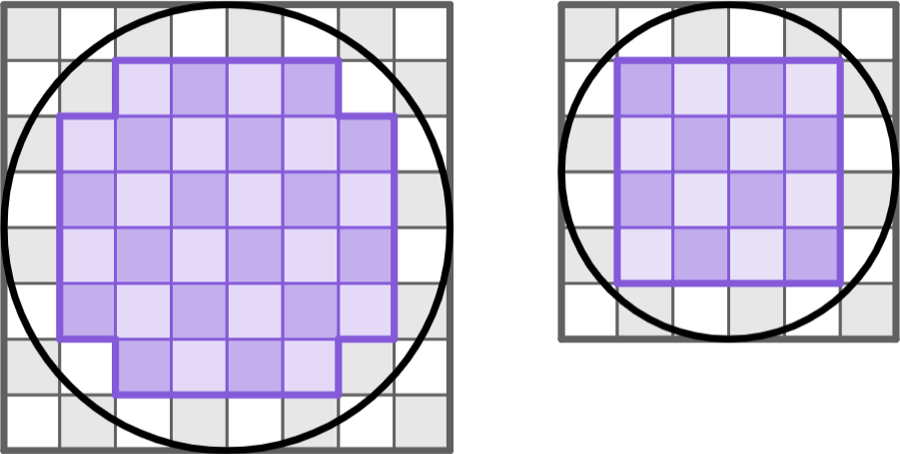
Area of a circle
Task A: Estimating areas of circles
1) For each diagram: i) find the number of complete squares inside the circle; ii) find the total number of squares; iii) complete the range for the area of the circle.
a)
b)
16
32
i) number of squares inside =
ii) total number of squares =
iii) units² < area of circle < units²
i) number of squares inside =
ii) total number of squares =
iii) units² < area of circle < units²
36
64
16
36
32
64
2) Use the information provided to fill in the gaps.
The area of each circle is between 2 and 4 times the area of its accompanying square.
a)
area = 9 m²
b)
4 m
c)
10 m
area = A m²
area = B m²
area = C m²
18
32
200
area of 2 squares = m²
area of 2 squares = m²
area of 2 squares = m²
36
64
400
area of 4 squares = m²
area of 4 squares = m²
area of 4 squares = m²
18
< A <
36
32
< B <
64
200
< C <
400

Slide 2
Area of a circle
Task B: Deriving the formula to calculate areas of circles
1) Each circle overlaps with a square. For each question:
i) Find the area of the square.
ii) Find the area of the circle in terms of π.
a)
b)
c)
4 cm
7 cm
9 cm
i) area of square =
81 cm²
i) area of square =
16 cm²
i) area of square =
49 cm²
ii) area of circle =
81π cm²
ii) area of circle =
16π cm²
ii) area of circle =
49π cm²
2) Each parallelogram is made from the sectors of one of the three circles. The diagrams are not drawn to scale.
10 m
20 m
10π m
5π m
C = 10π m
20 m
20 m
400π m²
25π m²
100π m²
a) Match each parallelogram with the circle of the same approximate area.
b) Find the area of each circle in terms of π.
Mathematics in Education and Industry.
v2.3

